Slide 1
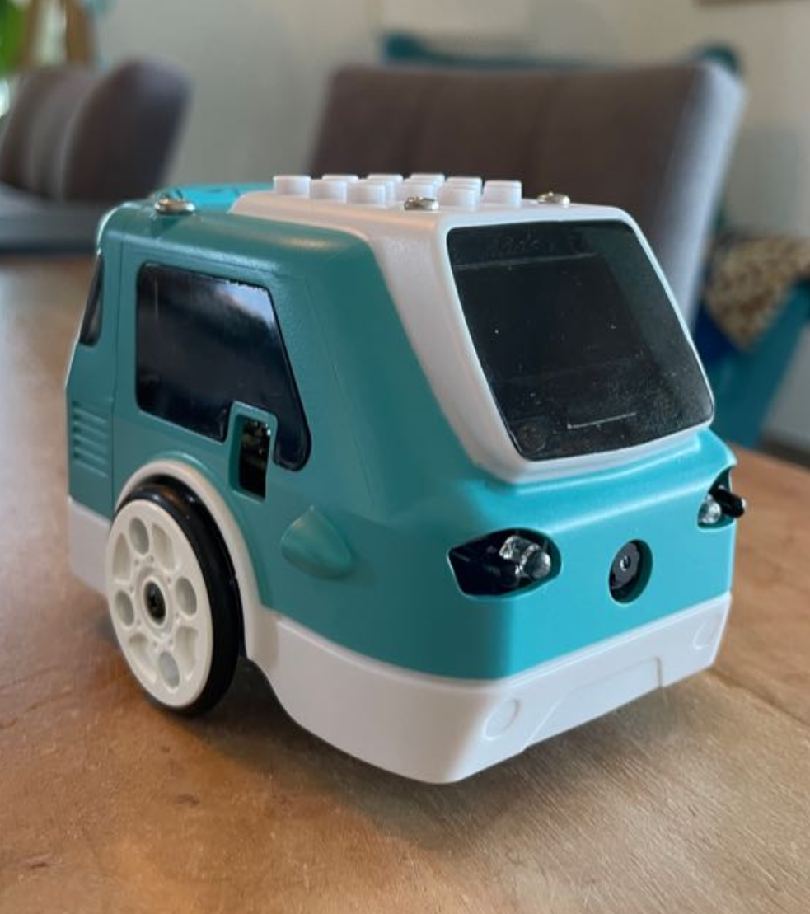
Zumi 7337
Team presentation
Simone Wullschleger
Mykhailo Andrusiak
Lea Schönauer

Slide 2
Presentation Overview
Successful Implementation Highlight of what worked well & why
Unsuccessful implementation Challenge we faced & what didn’t work
Lessons Learned
Team Q&A

Slide 3
Unsuccessful implementation
Vibration during running:
- Possible reason for a line_correction() function
- Possible solution is changing angle correction

Slide 4
Lessons Learned
Robots react to their environment
Test small, save big
Leverage what you already know

Slide 5

Team Q&A

